Slide 1
Building Blocks Agriculture

Slide 2
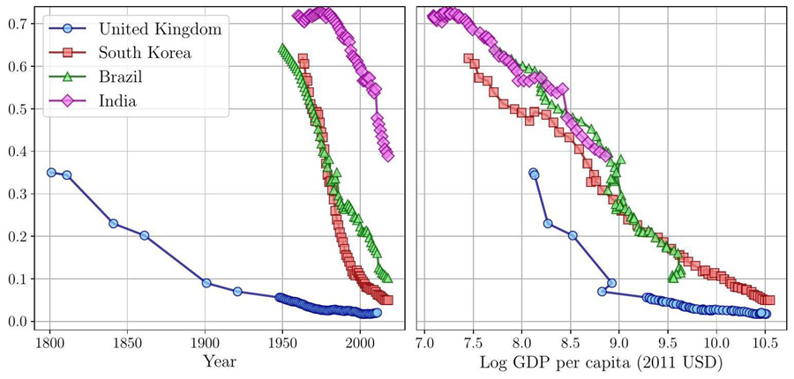
Notes:
https://voxdev.org/voxdevlit/industrial-development/structural-transformation-key-facts-and-canonical-theories

